Slide 1
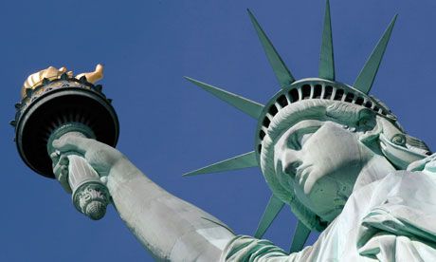
Who are America’s citizens?

Slide 2
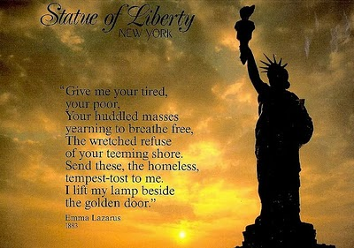

Slide 3
ISSUES to be discussed
Why is the topic of immigration so controversial in America?
What are the debates surrounding immigration?
What is America’s current immigration policy?
Should America maintain/increase the level of legal or documented immigration?
Who all is affected by undocumented immigration?
In what ways do immigrants affect U.S. society, our community, and your school?

Slide 4
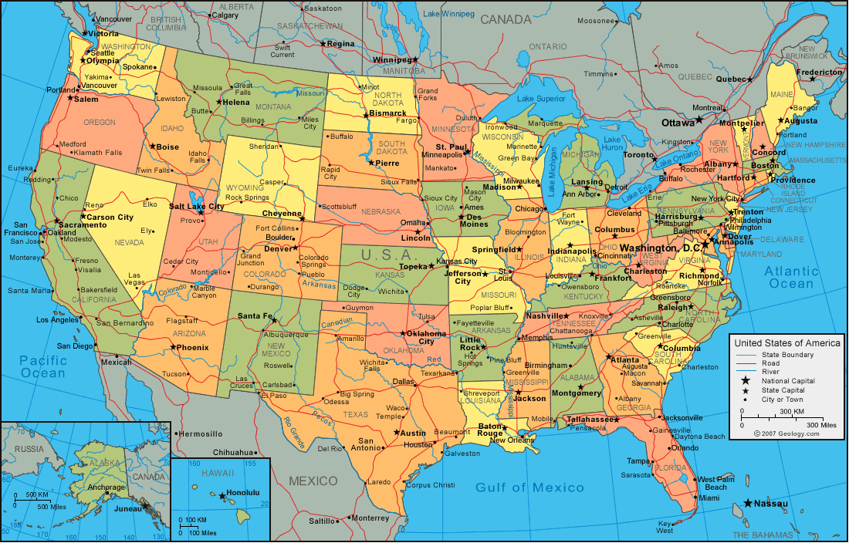

Slide 5
Bases of Citizenship
Jus soli -- right of birthplace
anyone born in U.S. is a citizen, even if your parents are here illegally
Jus sanguinis -- right of blood
Anyone born in another country to a parent who is a U.S. citizen

Slide 6
Steps In The Naturalization Process
File a Declaration of Intention
Live in U.S. for 5 years, 3 if married to citizen
Interview with U.S. Citizenship and Immigration Service (“USCIS”)
Take citizenship test
Question: What observations did you make about the citizenship test?
Pledge oath of allegiance

Slide 7
Requirements for Naturalization
At least 18 (kids become citizens if their parents become naturalized)
Good moral character
Murder is a permanent barrier; other major crimes
Must disclose all criminal convictions; better to tell truth than get found out
Must swear to support and defend the U.S. and the Constitution
Must be able to read, write, and speak ordinary English
Must pass test on U.S. history and govt.

Slide 8
What Might Help You Get Immigrant Status
You have an immediate relative who is a U.S. citizen; spouses and children get priority
You have a job offer in a badly needed area
Must get visa (paper which lets you stay here temporarily) or green card (lets you stay here permanently)
You’re going to invest $, especially if it helps create or save jobs
You are a refugee from a country where you might be killed or harmed because of your race, religion, political views, etc.
You don’t have any infectious diseases

Slide 9
How Are Political Rights of Aliens Restricted?
Alien = non-citizen; could be documented or undocumented
Aliens can’t:
Vote
Run for office
Serve on juries
Work in most govt. jobs
Must carry identification at all times

Slide 10
Benefits of Citizenship
Voting
Can be elected to public office
Passport allows you to travel freely, and get help from U.S. when you’re in trouble abroad
Kids automatically become naturalized
Might help you reunite your family

Slide 11
History of Immigration
Talk and Turn: Based on your notes from the “History of Immigration Video,” identify and describe five key events in immigration history.
Modern Changes:
1990s Immigration Law
Obama/Trump

Slide 12
Immigration Act of 1990
Shifted priority for immigration away from people related to U.S. citizens
Now we want people with special skills and talents, or money to invest.
Why is that?

Slide 13
Obama’s 2013 Immigration Policy: “Deferred Action for Childhood Arrivals (DACA)”
If you are an illegal immigrant and …
You’re under 30 years old
Arrived in the U.S. before you turned 16
You have lived in the U.S. for 5 years
You are currently in school, have a high school diploma or a GED, or are serving in the military
….. You won’t get deported if you’re caught (but only a 2 year reprieve)
You can’t have a criminal record
Allows young “illegals” to get a work permit, driver’s license, or maybe go to college

Slide 14
Trump and DACA
What has President Trump done about DACA?
What other policies has President Trump put forward regarding immigration?

Slide 15
Undocumented Immigration
Background Info:
There are approximately 12 million undocumented immigrants currently living in the U.S.
Undocumented immigrants cost the American taxpayers an estimate $113 million a year.
Issues:
Why are there so many people who are willing to take risks to come to the U.S. illegally?
What are the concerns with illegal immigration?
What, if any, steps should the U.S. take to stop illegal immigration?
What are the arguments for and against allowing illegal immigrants to work toward citizenship?

Slide 16
Undocumented Immigration
Pro
Con

Slide 17
Immigration Today
Do Now!
Key Facts About US Immigration Policies and Proposed Changes (Pew Research Center)
Growing Share of Republicans say U.S. risks losing its identity…(Pew Research Center)
Facts on U.S. Immigrants (Pew Research Center)

