Slide 1
Who Makes Foreign Policy?
The Constitution
The Executive Branch
Congress
The Judiciary
Interest Groups and Political Parties
Notes:
The basics of American foreign policy are laid out in the Constitution. The executive branch is the most powerful when it comes to foreign policy. Congress also plays an important role, but the Judiciary generally does not. In this section, we will explore how American foreign policy is made.

Slide 2
The Constitution
Foreign Policy Powers
Granted to the national government
Divided between the president and Congress
Presidential Powers
Commander in chief
Appoints ambassadors, subject to Senate approval
Congressional Powers
Funds military
Declares war
Notes:
The framers of the Constitution granted power to make foreign policy to the national government, not the states. They further divided authority for foreign policy between the president and Congress.
The president is commander in chief of the military, but Congress funds the military and formally declares war. The president appoints ambassadors and other key foreign policy officials, while the Senate confirms those appointments.

Slide 3
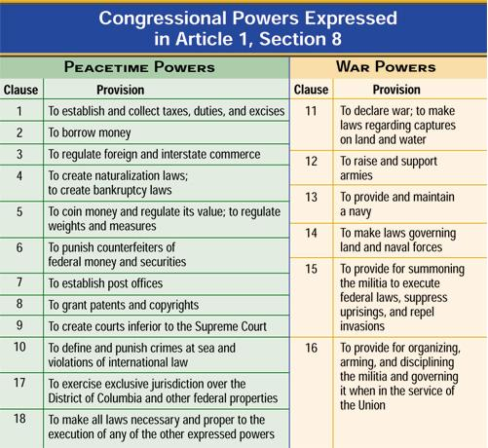

Slide 4
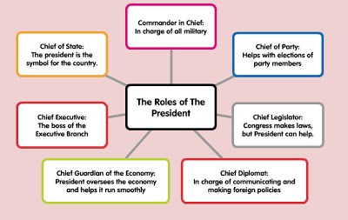

Slide 5
The Executive Branch
The President
Relies on National Security Council
The Departments of State, Defense, and Homeland Security
State Department formulates foreign policy.
Defense Department formulates military policy.
Joint Chiefs of Staff - Military advisory body that includes the Army chief of staff, the chief of naval operations, and the Marine commandant
Homeland Security straddles both areas.
The Intelligence Community
Central Intelligence Agency
Notes:
The executive branch determines foreign and defense policy. The president relies on the expertise of the National Security Council and his cabinet. The Department of State is generally in charge of formulating foreign policy. The Department of Defense formulates military policy, and the Department of Homeland Security straddles both policies.
The intelligence community comprises all the agencies involved in the collection and analysis of information. The Central Intelligence Agency had been the head of the intelligence community until the Director of National Intelligence was created after the 9/11 attacks. The DNI is aided in its efforts by the FBI, The Department of Homeland Security, and the National Security Agency.

Slide 6
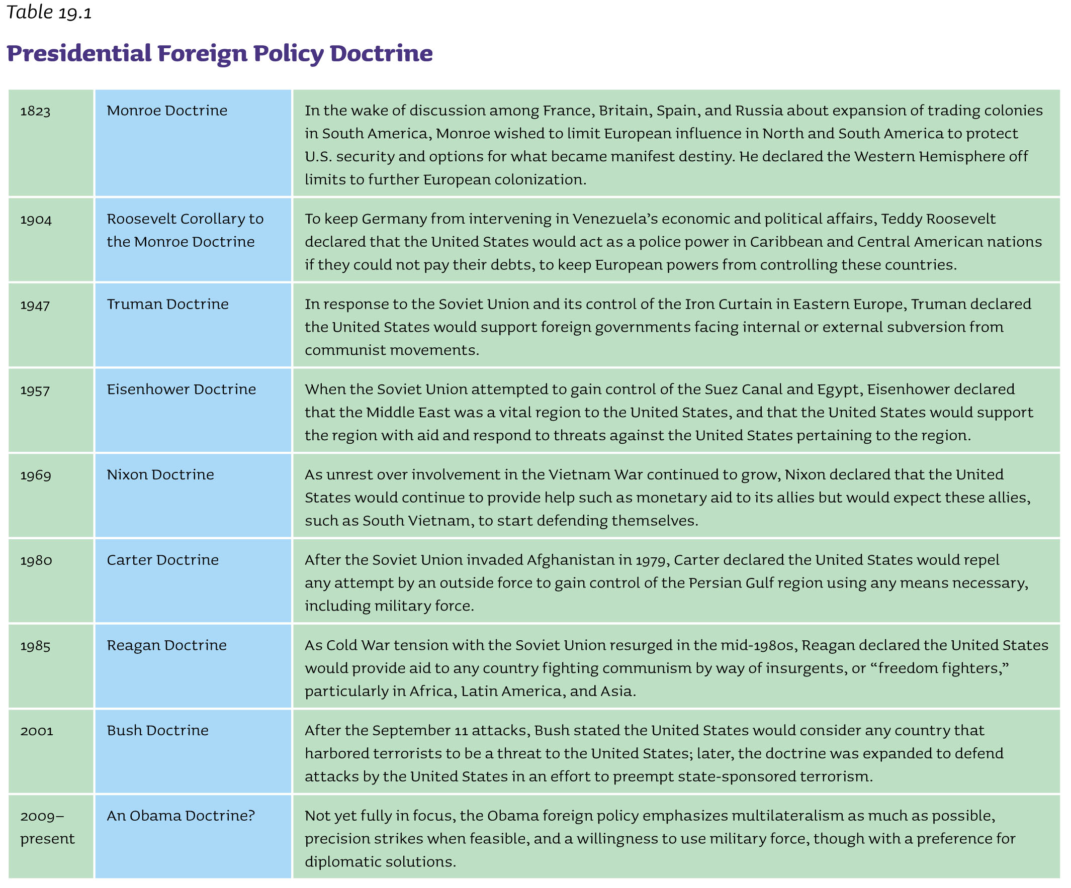

Slide 7
The Executive Branch
The President
Relies on National Security Council
The Departments of State, Defense, and Homeland Security
State Department formulates foreign policy.
Defense Department formulates military policy.
Joint Chiefs of Staff - Military advisory body that includes the Army chief of staff, the chief of naval operations, and the Marine commandant
Homeland Security straddles both areas.
The Intelligence Community
Central Intelligence Agency
Notes:
The executive branch determines foreign and defense policy. The president relies on the expertise of the National Security Council and his cabinet. The Department of State is generally in charge of formulating foreign policy. The Department of Defense formulates military policy, and the Department of Homeland Security straddles both policies.
The intelligence community comprises all the agencies involved in the collection and analysis of information. The Central Intelligence Agency had been the head of the intelligence community until the Director of National Intelligence was created after the 9/11 attacks. The DNI is aided in its efforts by the FBI, The Department of Homeland Security, and the National Security Agency.

Slide 8
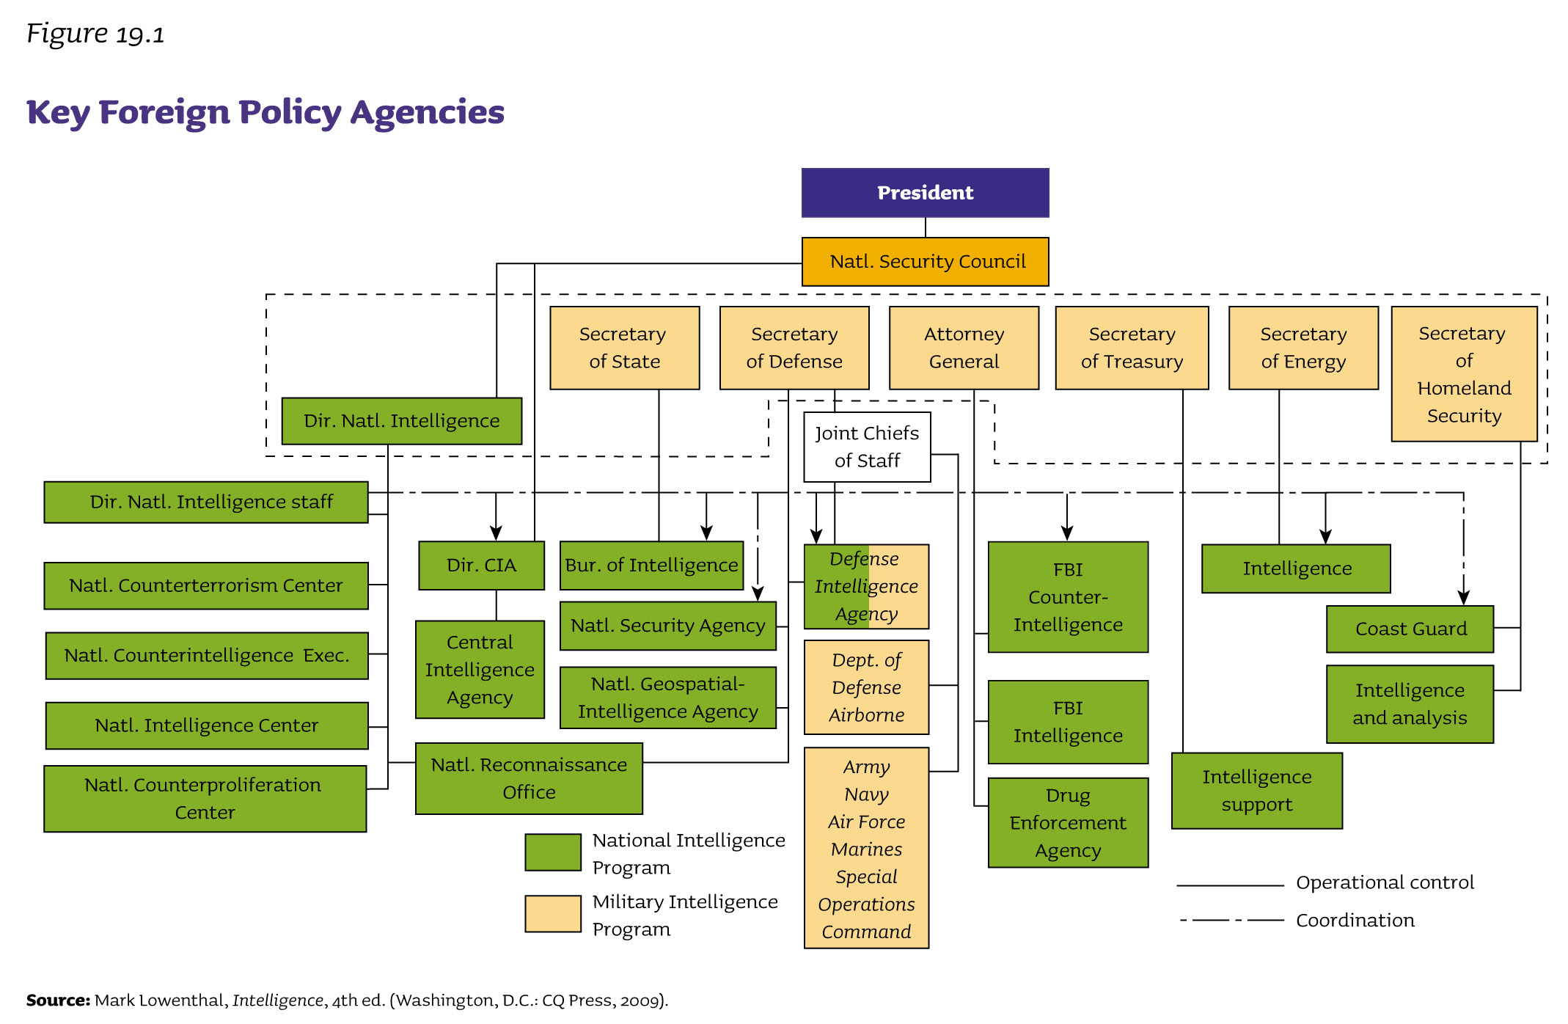

Slide 9
Congress
Oversight
Hearings to monitor agency actions
“Fact-finding” missions abroad
Treaties and Executive Agreements
Treaties require Senate approval, while executive agreements do not.
Appointments and Appropriations
Senate responsible for approving or rejecting presidential appointments
Can cut funding for military action
War Powers
War Powers Resolution
President reports to Congress within forty-eight hours.
Ineffective restraint on presidential power
Notes:
Congress does not have as much influence over foreign policy as the president does. It can hold hearings to monitor agency actions and conduct "fact-finding" missions abroad.
Treaties require Senate approval, and it is rare that the Senate does not approve them. Presidents have used executive agreements when they want to avoid getting the Senate's approval. These executive agreements usually deal with routine foreign matters, but they have also involved major military commitments.
The Senate approves key presidential foreign policy appointments.

Slide 10
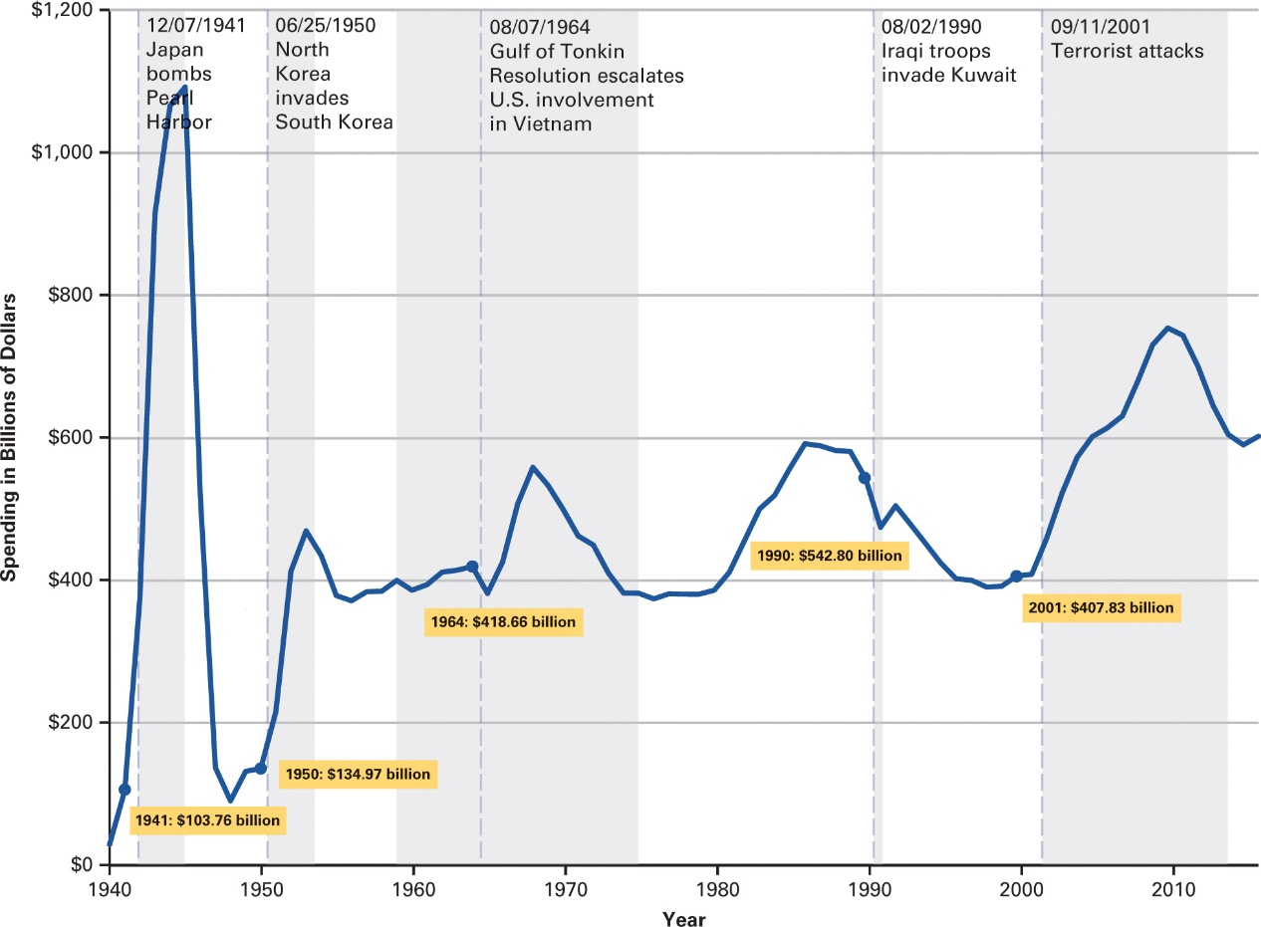
How Has Defense Spending Changed Over Time?
Source: US Office of Management and Budget, Table 3.1—Outlays by Superfunction and Function: 1940–2021.
Notes:
Defense spending was at its highest absolute levels during World War II, and at its second highest in the post-9/11 period. Above is chart on US spending on national defense since 1940, presented in billions of 2005 dollars.

Slide 11
Congress
Oversight
Hearings to monitor agency actions
“Fact-finding” missions abroad
Treaties and Executive Agreements
Treaties require Senate approval, while executive agreements do not.
Appointments and Appropriations
Senate responsible for approving or rejecting presidential appointments
Can cut funding for military action
War Powers
War Powers Resolution
President reports to Congress within forty-eight hours.
Ineffective restraint on presidential power
Notes:
Congress does not have as much influence over foreign policy as the president does. It can hold hearings to monitor agency actions and conduct "fact-finding" missions abroad.
Treaties require Senate approval, and it is rare that the Senate does not approve them. Presidents have used executive agreements when they want to avoid getting the Senate's approval. These executive agreements usually deal with routine foreign matters, but they have also involved major military commitments.
The Senate approves key presidential foreign policy appointments.

Slide 12
War Powers Act
Resolution The president is limited in the deployment of troops overseas to a 60 day period in peacetime and must notify Congress, within 48 hours, if troops are moved into hostilities or where hostilities are imminent,
Purpose: Meant to stop endless (Vietnam) and secret (Cambodia) wars
Questions:
What was Nixon’s Response? Why?
How has it been received since then?
Notes:
The president by and large reports to Congress but does so “consistent with, but not pursuant to” the provisions of the War Powers Act. Thus the 60-day clock does not start. Congress has been unable to start that clock on its own, though the act gives that option. One notable example of a negotiation over the clock was during the Reagan administration with troops in Lebanon. The 60-day clock was extended to an 18-month agreement with Congress. The recent debate over whether U.S. action in Libya constituted “hostilities” or not is an interesting current application.

Slide 14
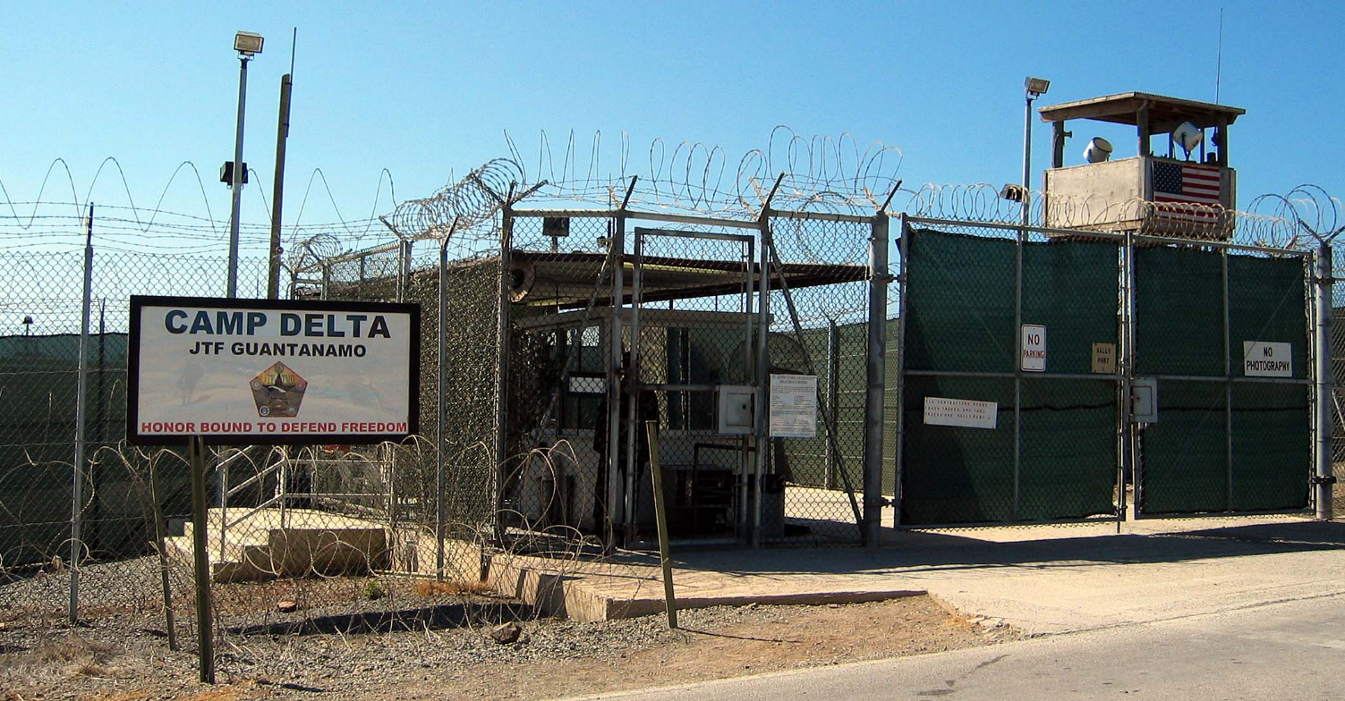
The Judiciary
Limited Role in Foreign and Defense Policy
Why are the federal courts unwillingness to intervene in such topics?
When do the courts intervene?
Notes:
The Judiciary's role in foreign and defense policy is fairly limited. The Court tends to dismiss disputes over foreign policy as political in nature.
On the relatively infrequent occasions in which the courts do intervene on foreign and military affairs, it is often to protect a core civil liberty. For instance, the federal courts have ruled on habeas corpus with respect to suspected terrorists who have been detained without trial at Guantanamo Bay, Cuba.

Slide 15
Interest Groups and Political Parties
Business Groups
Military-industrial complex
Ethnic Interest Groups
American-Israel Public Affairs Committees
Cuban-American National Foundation
Foreign Governments and Companies
Acquiring foreign aid, preventing hostile legislation
Ideological-Public Interest Groups
Think tanks, nongovernmental organizations
Disagreements along Party Lines
Republicans more assertive, unilateral
Democrats more inclined toward diplomacy, use of international institutions
Notes:
The federal government isn't the only party involved in foreign policy. Interest groups are also very active. We can break down the foreign policy interest groups into four categories.
Business groups, especially those connected to the defense industry, are active in foreign policy. Ethnic interest groups, such as the American-Israel Public Affairs Committee and the Cuban-American National Foundation, work to influence foreign policy.

Slide 16
Foreign Policy: Contemporary Challenges
The International Context
Trade
Terrorism
Nuclear Weapons
Global Climate Change
Notes:
We continue to face significant foreign and defense policy challenges. Four of the most important are trade, terrorism, nuclear weapons, and global climate change. We'll take an in-depth look at those three in this section.

Slide 17
Trade
Types of Trade Policy
Protectionism
Strategic trade policy
Free trade system
Making Trade Policy
Bilateral agreements
Regional trade agreements
NAFTA
Trans-Pacific Partnership
Global free-trade system
Notes:
When it comes to trade, countries tend to be protectionist, or engage in either strategic trade or free trade, although many countries mix some or all of these into their policies. Under protectionism, a country limits the import of foreign goods. Under strategic policy, governments target industries they want to see grow and support them using tax breaks or other benefits. Under free trade, there is limited government interference in trade.
To make trade policy, countries may follow one of three models. Bilateral trade agreements are between two countries. Regional trade agreements involve more than two countries but can be as few as three. The North American Free Trade Agreement, or NAFTA, is an example. Finally, there are global free trade agreements, such as the World Trade Organization.

Slide 18
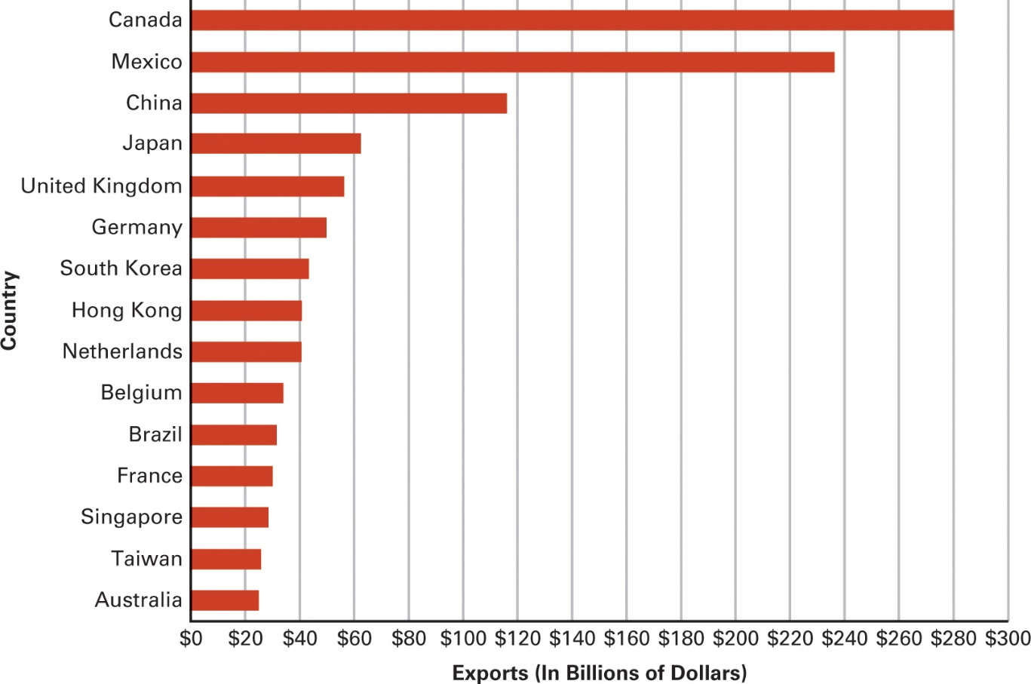
Figure 16.2 What Are the Major Markets for U.S. Exports?
Source: U.S. Census Bureau, Foreign Trade Statistics.
Notes:
The United States exports more goods to Canada than any other country. China, Mexico, and Japan also account for large shares of US exports. Above are US exports, in billions of dollars, to key trading partners in 2015.

Slide 19
Terrorism
Terrorism against the United States
Steady flow of assaults since 9/11
Fort Hood, 2009
Boston Marathon bombing, 2013
San Bernardino, CA, shooting 2015
The New Face of Terrorism
How Does ISIS Challenge the Civilized World?
Combating Terrorism?
Diplomacy
Military power
Economic power
Notes:
Terrorism can be defined as violence designed to achieve political intimidation and instil fear. Since 9/11, jihad-related terrorist activities within the United States have been limited but still have resulted in number of civilian casualties. Prominent examples have included a massacre at an army base in Fort Hood, Texas in 2009, the bombing of the Boston marathon in 2013, and shootings at a party in San Bernardino, California in
2015.
Countries like the U.S. have several tools in crafting counterterrorism policy, including diplomacy, military power, and economic power, such as sanctions.

Slide 20
Combating terrorism
Antiterrorism measures
Meant to defend us against a terror attack
E.g., metal detectors, full body scanners
Control access to violence, especially access to weapons of mass destruction
Counterterrorism measures
Meant to stop the terrorists before they attack
E.g., electronic surveillance, following money flows
Notes:
The Nunn-Lugar Cooperative Threat Reduction Program with the former Soviet Union attempts to control the supply side of nuclear technology. U.S. money goes to help protect and dismantle the old Soviet arsenal, and to employ former Soviet scientists, so that they don’t become available to the open market. For comparison, we have spent about as much on Nunn-Lugar in the last decade as we spent about every month in Iraq and Afghanistan.

Slide 21
Nuclear Weapons
Disarmament
Eliminating nuclear weapons
Slim prospects
Arms Control
Decreasing the number and types of weapons
Defense
Increasing capacity to block or intercept attacks
Counterproliferation
Using preemptive military action against threats
Notes:
Since the American bombings of the Japanese cities of Hiroshima and Nagasaki in 1945, the existence, proliferation, and potential use of nuclear weapons has been a central concern of U.S. foreign policy.
Several strategies traditionally have been in place to limit arms proliferation: disarmament, arms control, defense, and counterproliferation.
Disarmament takes the very existence of weapons as a cause for conflict and hopes to secure peace through eliminating them.
However, the current prospects for moving toward abolition of nuclear weapons seem very slim.
A second strategy is arms control. This approach takes the existence of conflict between countries as a given in world politics and attempts to find ways of reducing the chances that those conflicts will become deadly. Decreasing the numbers and types of weapons at the disposal of policy makers is one approach.
A third strategy is defense. Essentially, this goal encourages the creation of a system to block or intercept attacks from other countries, particularly by developing the capability to strike down nuclear-armed missiles.
A final strategy embraced by many countries today is counterproliferation. This involves the use, or at least threat, of preemptive military action against a threatening country or terrorist group. One of the major rationales for the 2003 invasion of Iraq by a U.S.-led multinational coalition was to eliminate the nuclear and other weapons of mass destruction alleged to exist there.

Slide 22
Emerging Challenges
China, Russia, Europe and the Middle East
Notes:
This concluding section considers emerging challenges facing the United States with regard to four critical world regions: China, Russia, Europe, and the Middle East and North Africa (MENA) region.

Slide 23
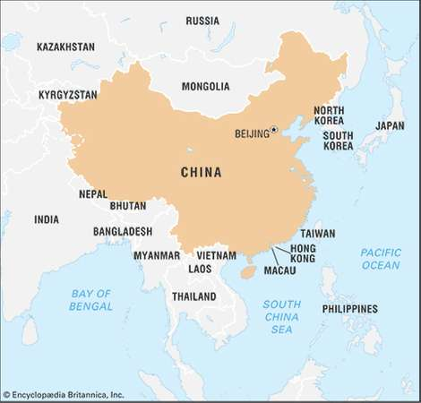
China
Both a Challenger and Logical Partner
China depends on the U.S. market.
U.S. borrows heavily from China.
China Is Modernizing Its Military Capabilities
Artificial islands in the South China Sea
U.S. response: deploying more military forces to the Pacific
Notes:
Both the United States and China benefit from trade and globalization; both want to limit the spread of nuclear weapons; and both are served by reining in countries such as Iran and North Korea that threaten peace and stability. Still there are considerable tensions and mistrust as well. China depends on the U.S. market to sell exports and fuel its economic growth. The United States borrows heavily from China, which finances growing U.S. budget deficits by purchasing American Treasury bonds. This type of interaction creates a potentially unhealthy mutual dependency for economic prosperity.
At the same time, China is modernizing its navy, missiles, aircraft, cyber warfare capabilities, and anti-satellite weapons. In a move deemed provocative by many of its neighbors, China has even constructed artificial islands in the South China Sea and
claimed sovereignty over them—giving it a stronger foothold for military action and a tighter grip on a major transit route for global trade. In response, the United States has begun deploying more military forces in the Pacific, including a new deployment
of 2,500 Marines in Australia. It has also strengthened and even expanded its partnership with India, Japan, South Korea, and other Asian countries who serve as regional counterweights to China in the Asia-Pacific region.

Slide 24
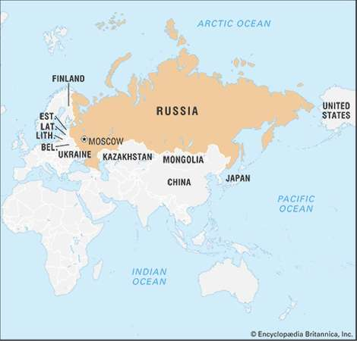
Russia
President Vladimir Putin’s Consolidation of Power
Control of Russian media
Repression of political dissent
Use of military
Invasions of Georgia, Ukraine
Intervention in Syria
US Election, 2016?
Russian Election, 2018
Notes:
Russia has begun to aggressively reassert the great-power status that it lost in the early 1990s with the collapse of the Soviet Union. Strongman President Vladimir Putin has consolidated power domestically by crushing terrorist threats from the Caucasus
region, taking control of Russian television and some other media, and by using heavy-handed tactics to suppress political dissent. Long propelled by high oil prices, Putin has cannily used his leverage to attempt to reestablish a zone of influence in
neighboring countries that had been part of the Russian Empire and the Soviet Union.
Where possible, Putin has used economic means, including promotion of a “Eurasian Economic Community” as a counterweight to the European Union. But Putin has also not hesitated to use military means, including outright invasions of former Soviet countries Georgia and Ukraine and an intervention in Syria to prop up his ally Bashar al-Assad. A global decline in the price of oil has curtailed Putin’s latitude for action, but Russia remains a continuing geopolitical rival for the United States.

Slide 25
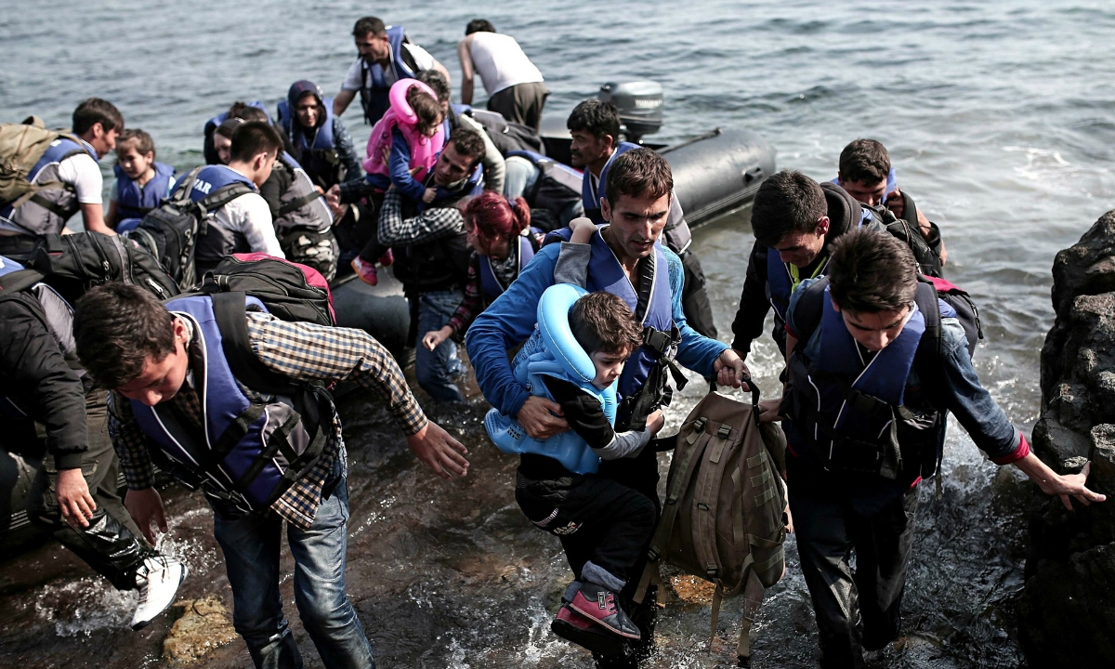
Europe
European Union
Twenty-eight member nations
Promotes cooperation rather than conflict
Severe challenges
Several countries at risk of default on loans
Massive inflows of refugees from Syria, Iraq, and other conflict zones
Terrorist attacks
U.K. withdrawal
Notes:
A cornerstone of European peace, prosperity, and democracy has been the 28-member European Union (EU). In recent years, however, the EU has faced severe challenges. Several countries, including Greece, Spain, Portugal, Italy, and Ireland, have run the risk of defaulting on their loans. This has undermined the Euro, the common currency shared by 17 EU nations, and required numerous bailouts by Europe’s richer countries, whose citizens are often resentful. At the same time, a crisis caused by massive flows of refugees from Syria, Iraq, and other conflict zones has escalated tensions within the EU and threatened the viability of its much-valued open borders and free flow of populations. Even worse has been a series of terrorist attacks, especially in France and Belgium, against which police and intelligence communities were unable to respond in an effective or coordinated fashion. Then on June 23, 2016, voters in the United Kingdom, who had long been ambivalent about EU membership, approved a referendum to begin the country’s withdrawal from the union

