Slide 1
Foreign Policy

Slide 2
Understanding foreign policy
Foreign Policy – area of policy making that encompasses how one country builds relationships with other countries in order to safeguard its national interest
Defense Policy – area of policy making that focuses on the strategies that a country uses to protect itself from its enemies
Notes:
The point of making this distinction is to note that a country’s actual behavior does not always match its stated policies, so we must endeavor to study both.

Slide 3
Foreign Policy – Key Concepts
Foreign Policy – A country’s official positions, practices, and procedures for dealing with actors outside its borders; it includes diplomacy and defense policy
Diplomacy – the formal system of communication and negotiation between countries
Defense Policy – area of policy making that focuses on the strategies that a country uses to protect itself from its enemies
Hegemon – the dominant actor in world politics

Slide 4
Foreign Policy – Key Concepts
Examples
Isolationism – View that nations should stay out of international political alliances and activities, and focus on domestic matters
Interventionism –View that the United States should actively engage in the affairs of other nations in order to try to shape events in accordance with US interests
Internationalism – a foreign policy based on taking an active role in global affairs; the predominant foreign policy view in the United States today

Slide 5
An Evolving Foreign Policy
Outline the major events and issues in the development of US foreign and defense policy

Slide 6
Isolationism in the Early Republic
Great Britain versus France
Hamilton favored British.
Jefferson favored French.
Isolationism
Sidestepping “entangling alliances”
Washington’s Farewell Address
Monroe Doctrine
Warned European powers to stay away from the Western Hemisphere
Notes:
The largest foreign policy challenge of the young republic was charting a safe course between European giants Great Britain and France. This was complicated by the fact that Alexander Hamilton and Thomas Jefferson disagreed; Hamilton wanted policies that favored the British, while Jefferson favored France.
Given these conflicts, young America, led by George Washington, embraced a policy of neutrality and isolationism. Washington, in his farewell address, urged Americans to steer clear of "entangling alliances."
When peace was established between France and Great Britain, Americans feared one or both countries would try to re-establish power in the Western Hemisphere. The Monroe Doctrine declared that any attempt to expand in this area would be seen as a danger to American safety.

Slide 7
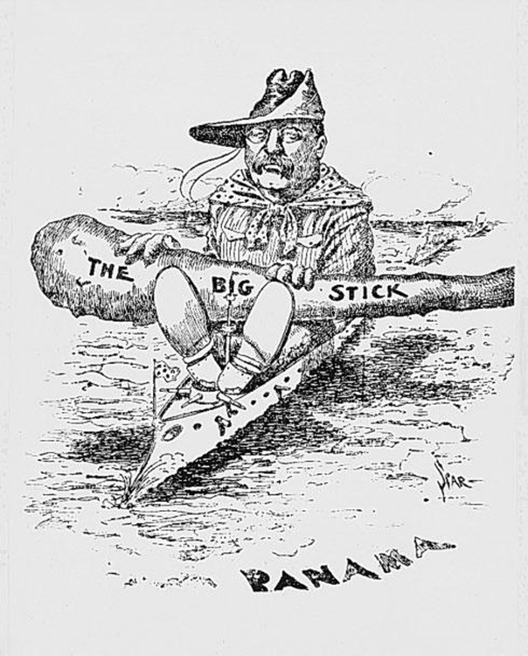
The United States: An Emerging Power
Trade Policy and Commerce
Tariffs
Most favored nation status
Continental Expansion and Manifest Destiny
Major land takings and purchases
Divine plan for expansion to the Pacific
Western Hemisphere
Roosevelt Corollary
Interests in Asia
Notes:
So, neutrality was the way early America did business. When it came to trade and commerce, the U.S. treated foreign traders the same way the traders treated Americans. Those countries that received most favored nation status were guaranteed the lowest tariffs on their imports. This lasted until the end of the Napoleonic Wars, when global trading increased.
Meanwhile, the U.S. was expanding across the continent by acquiring vast tracts of land. Manifest Destiny, the belief that God intended the U.S. to stretch from sea to sea, drove this expansion. By the the 20th century, the U.S. was clearly dominating the Western Hemisphere.
The Roosevelt Corollary revised the Monroe Doctrine; it stated that the U.S. was responsible for the stability of Latin America and the Caribbean. In terms of Asia, we took different paths for different countries. We sought open door policies for China, but tried to contain Japan through a series of international agreements.

Slide 8
World War I and Aftermath
U.S. Initially Neutral
European immigrants to United States deeply divided about the war
German Submarine Warfare
Wilson: fighting “to make the world safe for democracy”
United States entered war in 1917
League of Nations
Disarmament and Isolationism
Notes:
The United States initially remained neutral when World War I broke out. America was a nation of European immigrants, and so many were deeply divided on the issue.
But when German submarines sank U.S. ships carrying supplies to Great Britain and France, President Woodrow Wilson declared in 1917 that the U.S. would fight "to make the world safe for democracy."
Wilson succeeded in establishing a League of Nations based on the principle of "collective security," that an attack on one nation was an attack on all nations, but he failed to gain support at home and the United States did not join. The time between the two world wars was defined both by disarmament—getting other countries to limit arms—and by isolationism.

Slide 9
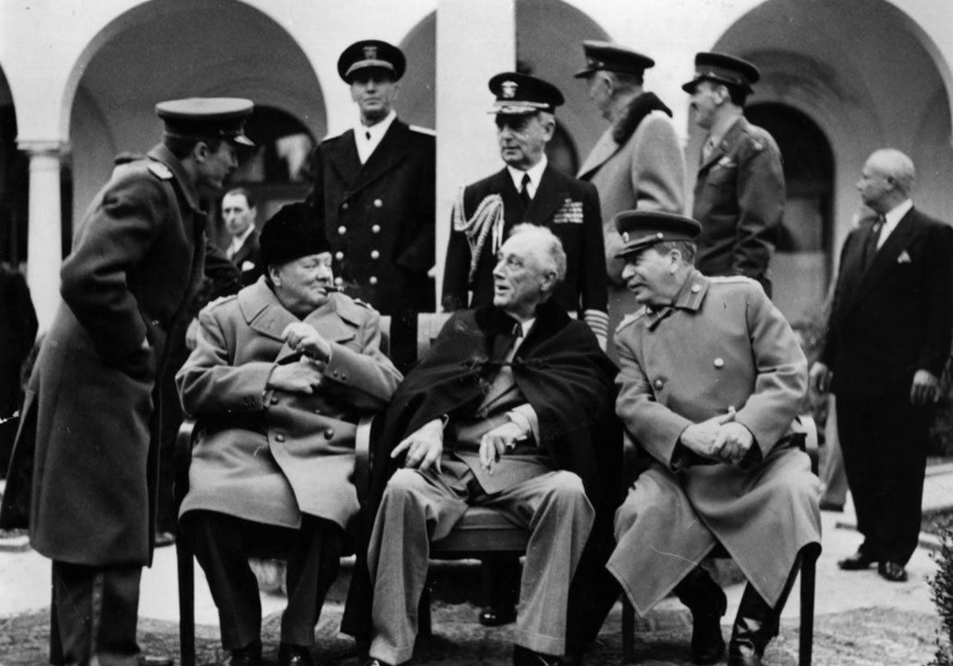
World War II and Its Aftermath
U.N. Security Council
America’s role: “leader of the free world”
President FDR
Active role in diplomacy
Economic Peace
International Monetary Fund (IMF)
World Bank
General Agreement on Tariffs and Trade (GATT)
Notes:
As you know, the U.S. entered World War II in 1941, after the Japanese bombed Pearl Harbor. Once the war was over, we helped create the United Nations, which replaced the League of Nations, and became permanent members of the Security Council.
During this time, President Franklin D. Roosevelt took an active role in diplomacy by engineering conferences with world leaders. Americans also sought to develop instruments of economic peace to encourage and manage global trade and finance. Thus, the International Monetary Fund, the World Bank, and the General Agreement on Tariffs and Trade were established.

Slide 10
The Cold War: Overview
Cold War: International conflict from the end of WWII to the collapse of communism in the late 1980s/early 1990s
Military Conflicts in the Cold War
Cuban Missile Crisis (1962): Closest the world has been to nuclear war
Korean War (1950–53): United States supported the South Korean regime against Communist forces in North Korea.
Vietnam War (1960s–75): United States supported South Vietnamese regime against Communist forces in North Vietnam.
Strategies
Containment: Opposition to Soviet expansion
Deterrence
Stockpile of nuclear weapons
“Mutually assured destruction” (MAD)
Notes:
The Cold War became the defining feature of the international system from the end of World War II all the way up to the collapse of communism in the late 1980s and early 1990s.
American foreign policy at this time centered on two philosophies: containment and deterrence. The policy of containment was used to oppose Soviet expansion around the world. We pursued deterrence by stockpiling enough nuclear weapons to convince the Soviets that any use of weapons on their part would end in "mutually assured destruction."

Slide 11
The Cold War and Containment
Truman Doctrine
Economic and military aid to countries fighting communism
Marshall Plan
U.S. financing of postwar rebuilding of Europe
North Atlantic Treaty Organization
Collective security pact
Berlin Wall
Divided communist East Berlin from democratic West Berlin
Notes:
American foreign policy also became known for helping other countries after the war. Under the Truman Doctrine, the United States provided economic and military aid to countries fighting communism.
Under the Marshall Plan, the United States financed the post-war rebuilding of Europe. In 1949, the United States, Canada, and Western Europe joined the North Atlantic Treaty Organization. NATO was a collective security pact. In retaliation, the Soviet Union organized Eastern Europe under the Warsaw Pact and further divided Europe by building the Berlin Wall, dividing communist East Berlin from democratic West Berlin.

Slide 12
The Cold War and Containment
Détente
Nixon declared end to “era of confrontation” (1969).
Strategic Arms Limitations Treaties (SALT I and SALT II)
Failed to establish rules related to involvement in developing world
The End of the Cold War
Carter’s focus: human rights
Reagan Doctrine
Mikhail Gorbachev’s reforms
Notes:
The Cold War thawed a bit with Nixon, who declared in 1969 that the "era of confrontation" was over and a new "era of negotiation" with the Soviets had begun. This era was called détente. The world also saw the Strategic Arms Limitations Treaties, which limited the stockpiling and deployment of nuclear weapons.
When Jimmy Carter became president, he turned from détente to focus on human rights violations. In particular, Carter targeted the Shah of Iran as a human rights abuser. The shah was forced into exile in 1979, but radical Iranians, with the help of Islamic extremists, took American embassy employees hostage. They were not released until over a year later, when Carter left office and Ronald Reagan was sworn in as president.
President Reagan had promised to restore U.S. military strength. The Reagan Doctrine, as it came to be called, was a commitment to combating communism by providing military aid to anti-communist groups.
Also around this time, Soviet leader Mikhail Gorbachev initiated a series of political and economic reforms meant to strengthen communism, but which ultimately led to the collapse of communist governments in Eastern Europe. Two years later, the Soviet Union collapsed and broke apart.

Slide 13
The Post–Cold War World
Gulf War (1991–92)
U.S.-led coalition reversed Iraq’s occupation of Kuwait.
President Bill Clinton
Promoted expansion of democracy and free markets
Secured passage of the North American Free Trade Agreement (NAFTA)
al-Qaeda
Began to attack American targets overseas (late 1990s)
Opposed U.S. involvement in Arab and Muslim countries
Led by Osama bin Laden
Notes:
President George H. W. Bush was the first American president to lead the U.S. in the post-Cold War world. It soon became clear what a world without two superpowers would be like: Iraq invaded Kuwait in August 1990, and in January 1991, Operation Desert Storm began.
President Bill Clinton sought to define a clear role for the United States in a post-Soviet Union world. He pushed for democratic enlargement, which meant actively promoting the expansion of democracy and free markets. Clinton secured Senate approval
for the North American Free Trade Agreement (NAFTA), an agreement promoting free movement of goods and services among Canada, Mexico, and the United States.
In the late 1990s, a little-known radical Islamic terrorist group known as al-Qaeda began to attack vulnerable American targets overseas. The group vehemently objected to the intrusion of U.S. troops into Arab and Muslim countries. Its leadership, including founder Osama bin Laden, operated from safe havens in the war-torn nation of Afghanistan and neighboring Pakistan. The group adopted a decentralized organization with a range of affiliates and associates, making it difficult for the United States to counter and giving it wide latitude to carry out its operations.

Slide 14
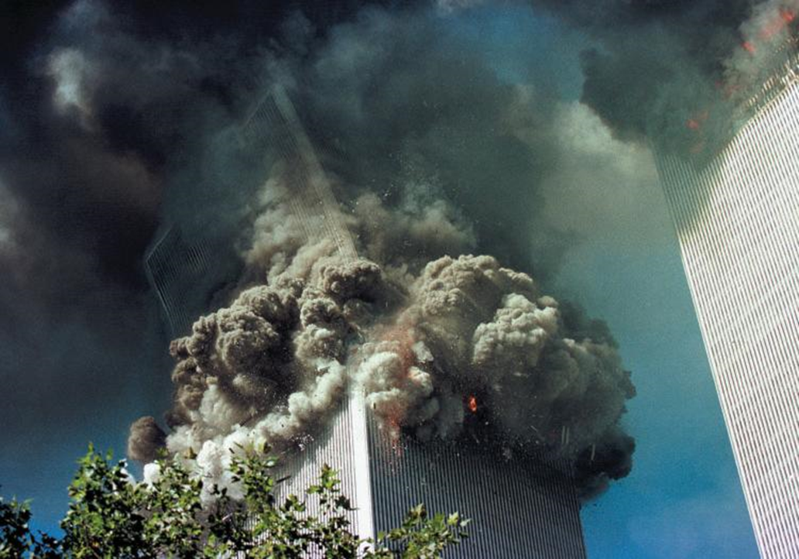
September 11th and the War on Terror
September 11
Nineteen members of al-Qaeda hijacked four commercial airplanes.
Two crashed into the World Trade Center, one into the Pentagon, and one in a field in Pennsylvania
The War in Afghanistan
U.S.-led coalition sought to depose the government and deny a safe haven to terrorists.
Osama bin Laden captured and killed in 2011
Notes:
President George W. Bush distanced himself from the Clinton expansionist policies that had led to U.S. intervention in foreign humanitarian crises. He rejected the international global warming treaty known as the Kyoto Protocol and refused to participate in other international efforts.
On September 11, 2001, 19 members of the terrorist group al-Qaeda headed by Osama bin Laden hijacked four planes. Two crashed into the World Trade Center, one into the Pentagon and one in a field in Pennsylvania. This sparked the global war on terrorism. The U.S. sent troops into Afghanistan to force the Taliban government to expel al-Qaeda. Although the government fell, terrorist groups remained as guerrilla fighters, and U.S. troops remained to fight them.
Activity: Ask the students to prepare an impromptu debate on the U.S. presence in Afghanistan. Choose two teams of four students to serve as opposing sides in the debate. Give them ten minutes to prepare arguments. Allot total debate time according to the demands of your class schedule. Ask the remaining students to act as debate judges.

Slide 15
September 11th and the War on Terror
The War in Iraq
President George W. Bush declared Iraq, North Korea, and Iran an “axis of evil.”
Operation Iraqi Freedom (2003)
Divided Americans
Not intended to be a long, drawn-out war
Last American combat forces left in 2011.
New Terrorist Threats
ISIS
Notes:
In his 2002 State of the Union Address, President George W. Bush declared Iraq, North Korea, and Iran an "axis of evil." Not long after, Operation Iraqi Freedom began on March 19, 2003. Within a month, the capital city of Baghdad fell and Bush declared "mission accomplished." Casualties began to mount in what become a long, drawn-out war, and it wasn't until December, 2011, that the last combat forces pulled out of Iraq.
Following massive upheaval across the Middle East, a virulent new terrorist threat has arisen—the Islamic State in Iraq and Greater Syria, commonly known by the initials ISIS or, sometimes, ISIL. Displaying extreme and graphic brutality, but also an exceptional adeptness in the use of social media and other forms of propaganda, ISIS poses a major challenge to U.S. foreign and defense policy.

